Slide 1
Eco1011S edu MCQ Exam workshop
2024

Slide 2
General TIPS + Reminders
Do Long questions first (No negative marking there)
Most Correct Response
Tuts + Whiteboards
You are a Winner – No matter what the year mark is

Slide 3
1. An expansionary monetary policy tends to
decrease inflation.
increase taxes.
increase aggregate demand.
increase interest rates.
increase budgetary deficits.

Slide 4
1. An expansionary monetary policy tends to
decrease inflation.
increase taxes.
increase aggregate demand.
increase interest rates.
increase budgetary deficits.

Slide 5
2. If the interest rate increases, the opportunity cost of holding money in liquid form ____, and the quantity of money demanded __________. Ignore any impact from the forex market in this question.
does not change; does not change
decreases; also decreases
increases; decreases
decreases; increases
increases; increases

Slide 6
2. If the interest rate increases, the opportunity cost of holding money in liquid form ____, and the quantity of money demanded __________. Ignore any impact from the forex market in this question.
does not change; does not change
decreases; also decreases
increases; decreases
decreases; increases
increases; increases

Slide 7
Which of followings statements is correct?
When employment is high, the cost of job loss is lower, and workers expect higher real wages.
When employment is low, the cost of job loss is high, and workers expect higher real wages.
When employment is lower, the cost of job loss is low, and government to intervene.
When firms can always accurately forecast inflation because they have more inflation than households.
None of the above.

Slide 8
Which of followings statements is correct?
When employment is high, the cost of job loss is lower, and workers expect higher real wages.
When employment is low, the cost of job loss is high, and workers expect higher real wages.
When employment is lower, the cost of job loss is low, and government to intervene.
When firms can always accurately forecast inflation because they have more inflation than households.
None of the above.

Slide 9
Assume the inflation rate falls from 4 percent to 2 percent. This means that:
the price level has decreased.
the economy is experiencing deflation.
the price level is increasing more slowly.
the economy is experiencing hyperinflation.
real GDP is decreasing.

Slide 10
Assume the inflation rate falls from 4 percent to 2 percent. This means that:
the price level has decreased.
the economy is experiencing deflation.
the price level is increasing more slowly.
the economy is experiencing hyperinflation.
real GDP is decreasing.

Slide 11
WHICH OF THE FOLLOWING IS TRUE?
A wage-price spiral occurs if an increase in the price level is followed by an increase in wages.
A wage-price spiral occurs if an increase in wages is followed by an increase in the price level.
The bargaining gap is the difference between the nominal wage offer to workers and the real wage that maximises profits.
If unemployment is higher than at the labour market equilibrium, the bargaining gap is negative.
If unemployment is lower than at the labour market equilibrium, the bargaining gap is negative.

Slide 12
WHICH OF THE FOLLOWING IS TRUE?
A wage-price spiral occurs if an increase in the price level is followed by an increase in wages.
A wage-price spiral occurs if an increase in wages is followed by an increase in the price level.
The bargaining gap is the difference between the nominal wage offer to workers and the real wage that maximises profits.
If unemployment is higher than at the labour market equilibrium, the bargaining gap is negative.
If unemployment is lower than at the labour market equilibrium, the bargaining gap is negative.

Slide 13
6. AmericanS demand South African Rands in order to
buy South African goods.
supply American Dollars in the South African market.
balance the current account
Invest the Rands in the American banking system
allow South Africans to buy American goods.

Slide 14
6. AmericanS demand South African Rands in order to
buy South African goods.
supply American Dollars in the South African market.
balance the current account
Invest the Rands in the American banking system
allow South Africans to buy American goods.

Slide 15
When the SARB adjusts the repo rate, the change in interest rates tends to affect net exports in the economy. To which of the channels of the broad monetary transmission mechanism does this effect belong to?
The money stock channel.
Profit expectations and consumer confidence.
The credit channel.
The exchange rate channel.
The asset price channel.

Slide 16
When the SARB adjusts the repo rate, the change in interest rates tends to affect net exports in the economy. To which of the channels of the broad monetary transmission mechanism does this effect belong to?
The money stock channel.
Profit expectations and consumer confidence.
The credit channel.
The exchange rate channel.
The asset price channel.

Slide 17
An expansionary monetary policy increases aggregate demand by
lowering interest rates which increases investment spending
lowering interest rates which increases government spending.
raising interest rates which increases government spending.
lowering interest rates which decreases taxes.
reducing government spending which increases investment spending through the multiplier.

Slide 18
An expansionary monetary policy increases aggregate demand by
lowering interest rates which increases investment spending. (Saving vs Investments)
lowering interest rates which increases government spending.
raising interest rates which increases government spending.
lowering interest rates which decreases taxes.
reducing government spending which increases investment spending through the multiplier.

Slide 19
9. Suppose the exchange rate between the Rand and the Dollar changes from R15/$ to R18/$, this means that
the Rand has appreciated
the dollar has appreciated
both the Rand and the Dollar has depreciated
the Rand has depreciated and the Dollar has appreciated
the Dollar has depreciated and the Rand has appreciated.

Slide 20
9. Suppose the exchange rate between the Rand and the Dollar changes from R15/$ to R18/$, this means that
the Rand has appreciated
the dollar has appreciated (THIS IS CORRECT AS WELL)
both the Rand and the Dollar has depreciated
the Rand has depreciated and the Dollar has appreciated (MOST CORRECT)
the Dollar has depreciated and the Rand has appreciated.

Slide 21
10. As the value of South African exports _________, the demand for Rands ________ while the supply of Dollars _______.
increases; increases; decreases
increases; decreases; increases
decreases; decreases; decreases
decreases; increases; decreases
Increases; increases; increases

Slide 22
10. As the value of South African exports _________, the demand for Rands ________ while the supply of Dollars _______.
increases; increases; decreases
increases; decreases; increases
decreases; decreases; decreases
decreases; increases; decreases
Increases; increases; increases

Slide 23
11. The lower the exchange rate today, all else equal, the
greater is the expected profit from buying U.S. dollars today and holding them.
smaller is the expected profit from buying U.S. dollars today and holding them.
greater is the expected profit from buying foreign currency today and holding it.
smaller the quantity of U.S. dollars demanded in the foreign exchange market today.
greater is the expected profit from investing in the US banking system.

Slide 24
11. The lower the exchange rate today, all else equal, the (Confusing question wording)
greater is the expected profit from buying U.S. dollars today and holding them.
smaller is the expected profit from buying U.S. dollars today and holding them.
greater is the expected profit from buying foreign currency today and holding it.
smaller the quantity of U.S. dollars demanded in the foreign exchange market today.
greater is the expected profit from investing in the US banking system.

Slide 25
12. A five-year bond has a face value of R10000 and a coupon rate of 5%. At an interest rate of 12%, how much should the bond trade for now? The first coupon will be paid one year
R6366.67
R4901.65
R7476.66
R8560.50
R12500

Slide 26
12. A five-year bond has a face value of R10000 and a coupon rate of 5%. At an interest rate of 12%, how much should the bond trade for now? The first coupon will be paid one year
R6366.67
R4901.65
R7476.66
R8560.50
R12500

Slide 27
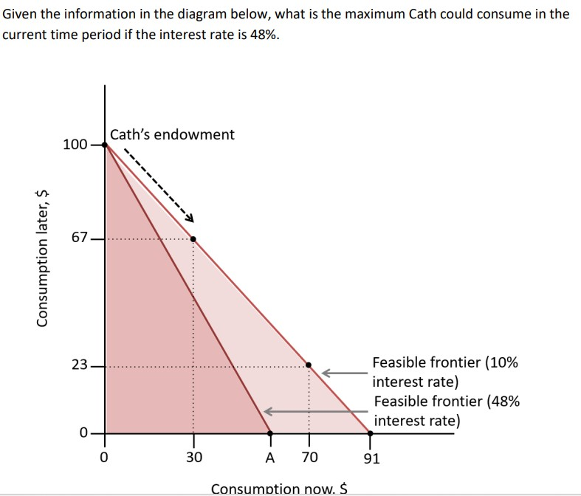
13.
R30
R67.57
R70
R74.50
R91

Slide 28
13.
R30
R67.57
R70
R74.50
R91

Slide 29
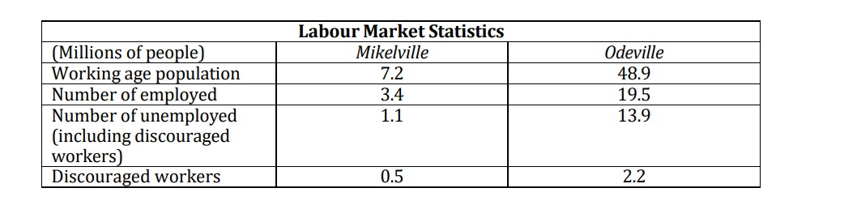
14. How many individuals in Odeville are not economically active if we are using the strict definition of unemployment.
2.2 million
17.7 million
33.4 million
31.2 million
48.9 million

Slide 30
14. How many individuals in Odeville are not economically active if we are using the strict definition of unemployment.
2.2 million
17.7 million
33.4 million
31.2 million
48.9 million

Slide 31
Working-age Population
15-64 years
31.3 million
Labour Force
17.1 million
Employed
12.8 million
Unemployed
4.3 million
Not Economically active
14.2 million
Discouraged workers
1.8 million
Not available to work
12.4 million

Slide 32
15. In Mikelville, what is the strict unemployment rate?
7.2%
13.4%
15.0%
15.3%
24.4%

Slide 33
15. In Mikelville, what is the strict unemployment rate?
7.2%
13.4%
15.0%
15.3%
24.4%

Slide 34




Slide 35
Working-age Population
15-64 years
31.3 million
Labour Force
17.1 million
Employed
12.8 million
Unemployed
4.3 million
Not Economically active
14.2 million
Discouraged workers
1.8 million
Not available to work
12.4 million

Slide 37
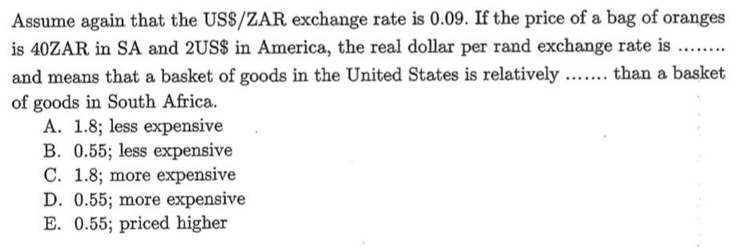
16.

Slide 38
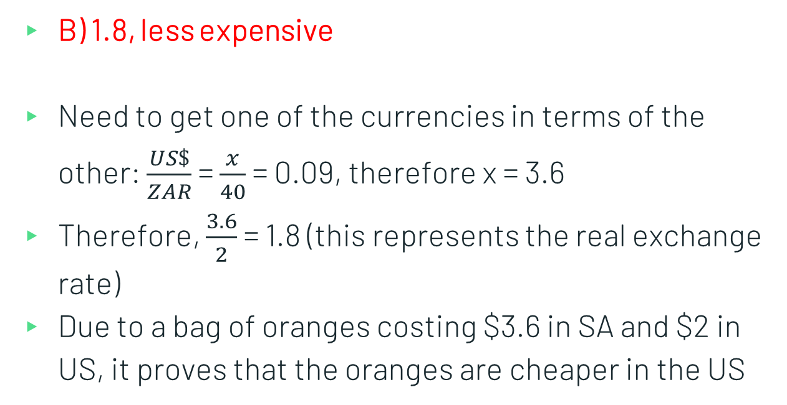
16.
B) 1.8, less expensive
Need to get one of the currencies in terms of the other: $\frac{US\$}{ZAR}$ = $\frac{x}{40}$ = 0.09, therefore x = 3.6
Therefore, $\frac{3.6}{2}$ = 1.8 (this represents the real exchange rate)
Due to a bag of oranges costing $3.6 in SA and $2 in US, it proves that the oranges are cheaper in the US

Slide 39
17. Assume an exchange rate of $1= R12.73. A South African product sells in the United States for $18. By what percentage will the rand revenues change from the sale of one unit of the product in the United States if the dollar is worth R11.55?
+21.24%
+10.22%
+3.25%
-4.7%
-9.28%

Slide 40

17. Assume an exchange rate of $1= R12.73. A South African product sells in the United States for $18. By what percentage will the rand revenues change from the sale of one unit of the product in the United States if the dollar is worth R11.55?
E) -9.28%
R12.73 x $18 = R229.14
R11.55 x $18 = R207.90
Therefore, % change = $\frac{New −old}{old}$ x 100 = $\frac{207.90 −229.14}{229.14}$ x 100 = -9.2694%

Slide 41
18.
Suppose the US Federal Reserve Bank (the “Fed”) wants to fix the
U.S. dollar/Mexican peso rate at 11 pesos per dollar under a
fixed exchange rate policy. If the exchange rate falls to 10 pesos per dollar,
the Fed can: A. Buy dollars
B. Sell dollars
C. Attempt to freeze all sales of dollars
D. Any of the above actions could take place

Slide 42
18.
A) Buy Dollars
Explanation : Buying dollars decreases the amount of money in the economy…
For a Fixed Exchange Rate Regime: the exchange rate is pegged at a target value decided by the government or the Central Bank.
Forces of demand and supply are blocked by direct intervention in the foreign exchange market.
Requires active intervention in the Forex market
FED must sell Dollars (↑S) to prevent appreciation.
FED must buy Dollars (↑D) to prevent depreciation.

Slide 43
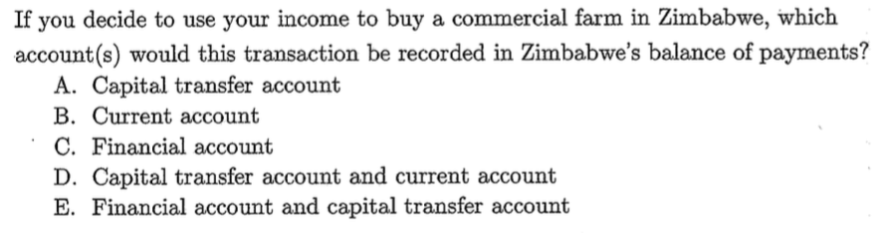
19.

Slide 44
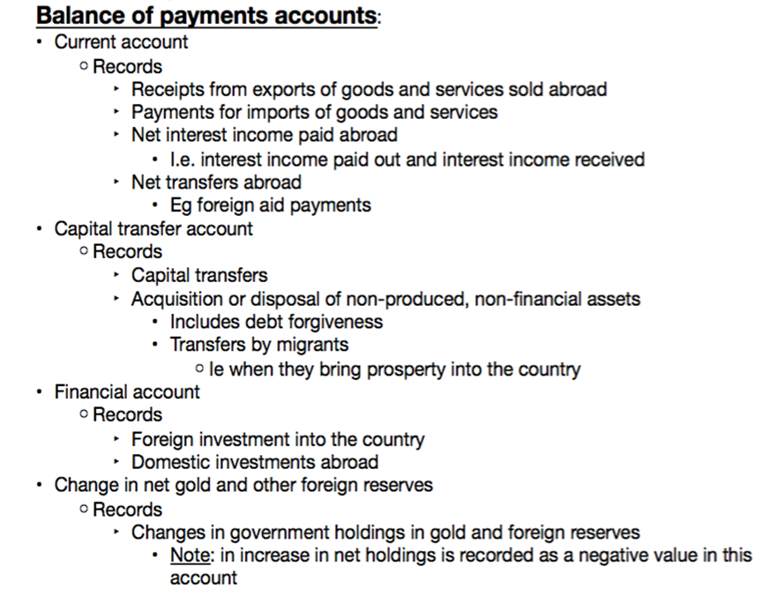
19.
Current Account
Imports & exports
Capital Transfer Account
Largely debt forgiveness: part of the amount loand not required to be repaid
Includes foreign reserves
Financial Account
International movement of financial assets
Direct investment, portfolio investment, other investment and reserve assets
Payments & receipts
Transfers (between local and international residents)
Trade in services
C) Financial Account

Slide 45
20.
Which of the following statements is/are true?
Positive net exports can compensate for low government spending in reaching a target GDP.
Positive net exports reduce the value of GDP.
Positive net exports imply that the value of imports exceeds the value of exports.
Positive net exports imply that the value of exports exceeds the value of imports.
All of the above
i, iii and iv
ii and iv
ii and iii
i and iv

Slide 46
20.
E) i and v
GDP = C + I + G + X – Z
Therefore, GDP is positive if NX (Net Exports) is positive, i.e. exports exceed imports
Furthermore, if NX is positive, this can compensate for low government spending

Slide 47
2. If the interest rate increases, the opportunity cost of holding money in liquid form ____, and the quantity of money demanded __________. Ignore any impact from the forex market in this question.
does not change; does not change
decreases; also decreases
increases; decreases
decreases; increases
increases; increases

Slide 48
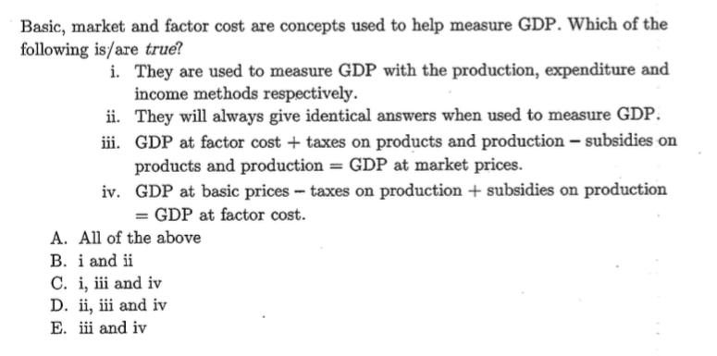
21.

Slide 49
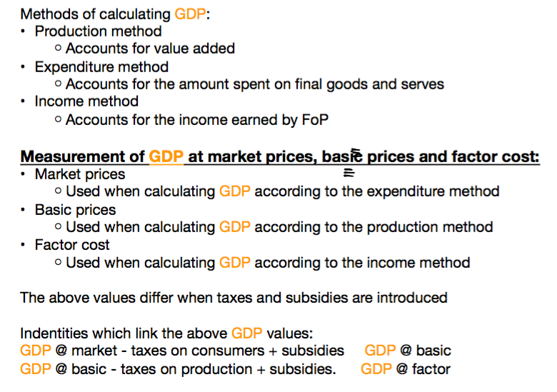
21.
C) i, iii and iv

Slide 50
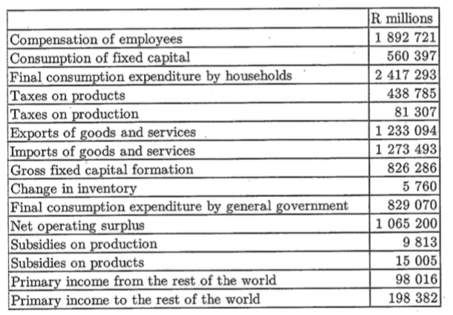
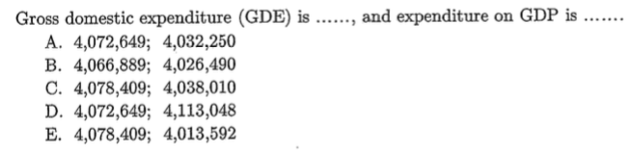
22.

Slide 51
22.
GDP = C + I + G + (X – Z)
C: consumption spending
Private Spending – the amount spent by private households in a year
Excludes investment and transfer payments
Government spending
I: investment spending (Gross capital formation)
Inventory accumulation (changes In inventories)
Fixed capital formation
Does not include sale of an existing capital good (e.g. house)
NET I = GROSS I – REPLACEMENT I
(X – Z): net exports
X = Exports & Z = Imports

Slide 52
22.
C) 4 078 409, 4 038 010
GDE = C + I + G
Therefore: GDE = 2 417 293 + (826 286 + 5 760) + 829 070
Therefore, GDE = 4 078 409
GDP = GDE + X – Z
Therefore: GDP = 4 078 409 + 1 233 094 – 1 273 493
Therefore: GDP = 4 038 010

Slide 53
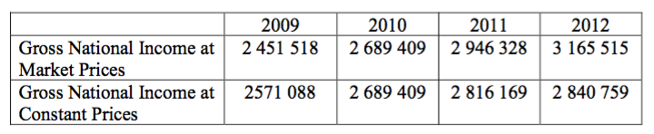
23.
In these accounts the base year for the calculation of
“Constant” prices is:
a) 2009
b) 2010
c) 2011
d) 2012
e) 2016

Slide 54
23.
B) – 2010
Base period – is where “things” (quantities/prices depending on the question)
will remain the same
Therefore, there will be no change between market prices and constant prices
NB! For CPI the base period will always be 100

Slide 55
24.
In 2012 the GDP Deflator was:
a) 100.9
b) 105.6
c) 107.4
d) 111.4
e) 117.7

Slide 56
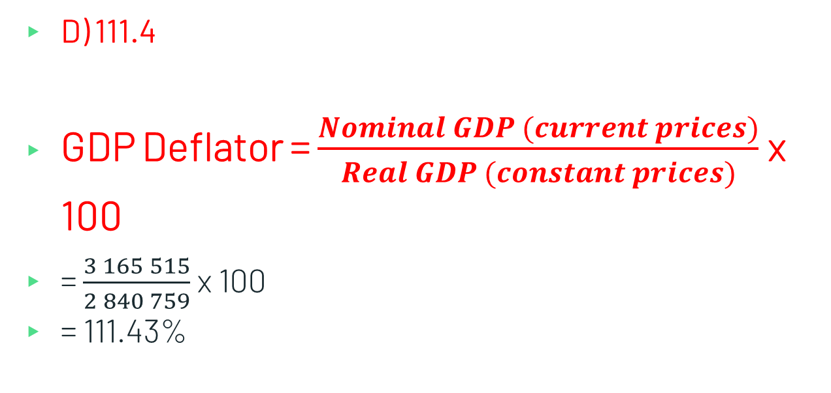
24.
D) 111.4
GDP Deflator = $\frac{Nominal GDP (current prices)}{Real GDP (constant prices)}$ x 100
= $\frac{3 165 515}{2 840 759}$ x 100
= 111.43%

Slide 57
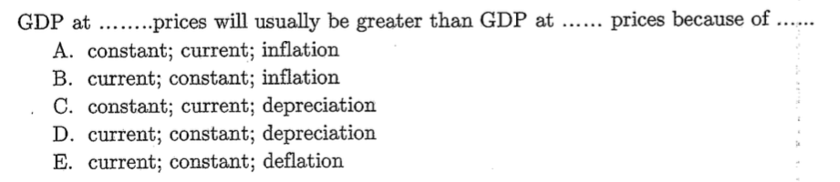
25.

Slide 58
25.
B) current, constant, inflation
Constant prices do not change with a change in price level
Current prices change based on changes in the price level
(e.g. inflation)

Slide 59
25.

Slide 60
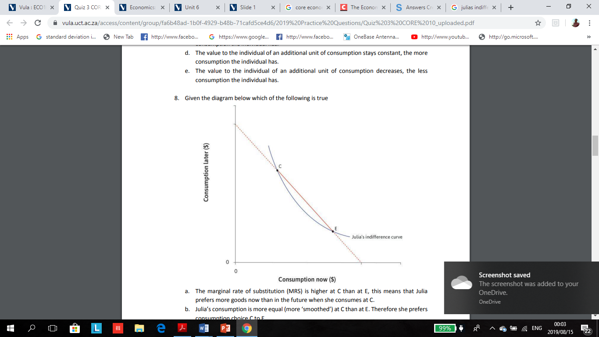
26.
Given the diagram which of the following is true?
a. The marginal rate of substitution (MRS) is higher at C than at E, this means that Julia prefers more goods now than in the future when she consumes at C.
b. Julia’s consumption is more equal (more ‘smoothed’) at C than at E. Therefore she prefers consumption choice C to E.
c. The marginal rate of substitution (MRS) is lower at E than at C, this means that Julia prefers more goods now than in the future when she consumes at E.
d. The marginal rate of substitution (MRS) is the same at each point on Julia’s indifference curve.
e. The marginal rate of substitution (MRS) is lower at E than at C, this means that Julia prefers more goods now than in the future when she consumes at E.

Slide 61
26.
Answer: C
A. The marginal rate of substitution (MRS) is higher at C than at E, this means that Julia prefers more goods in the future when she consumes at C than she does now.
B. Future consumption dominates current consumption at C
C. The lower the MRS the greater the preference for current consumption. Julia prefer more goods in the future than now at E.
D. Julia’s indifference curve is not a straight line, the slope of the graph becomes less steep the greater current consumption Julia has. Since the slope is not constant the MRS is also not constant.
E. The marginal rate of substitution (MRS) is lower at E than at C, this means that Julia prefers more goods now than in the future when she consumes at E.

Slide 62
27.
In a closed economy with no government, an increase in autonomous investment of R25 billion increases domestic output from R600 billion to R700 billion. The marginal propensity to consume is
0.25 and the multiplier is 4.
0.5 and the multiplier is 2.
0.675 and the multiplier is 3.
0.75 and the multiplier is 4.
0.80 and the multiplier is 5.

Slide 63
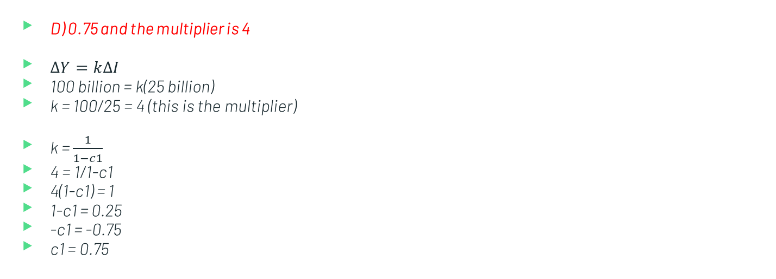
27.
D) 0.75 and the multiplier is 4
$∆Y=k∆I$
100 billion = k(25 billion)
k = 100/25 = 4 (this is the multiplier)
k = $\frac{1}{1−c1}$
4 = 1/1-c1
4(1-c1) = 1
1-c1 = 0.25
-c1 = -0.75
c1 = 0.75

Slide 64
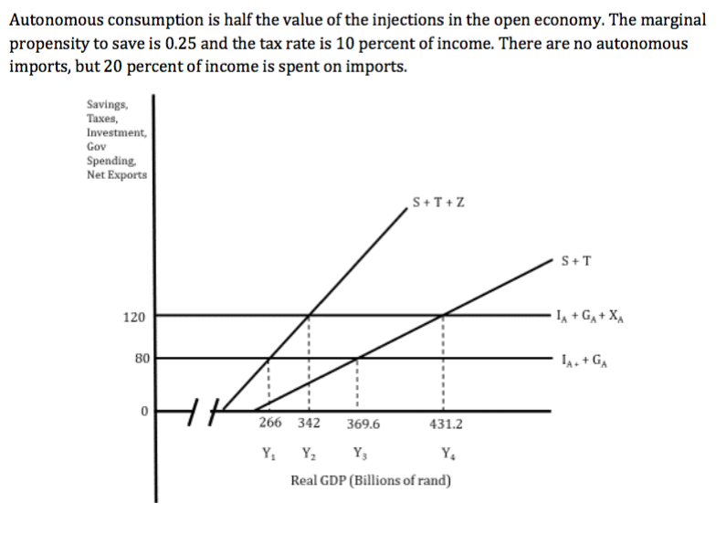
28.
The equilibrium level of output in this open economy with government is
Y1.
Y2.
Y3.
Y4.
More information about aggregate expenditure is required to calculate the equilibrium
Y.

Slide 65
28.
B – Y₂
Equilibrium will be where your injections = withdrawals
Therefore, equilibrium will be where: S + T + Z (import) = I + G + X (exports)
Therefore, equilibrium occurs at Y₂.

Slide 66
29.
The consumption function in the open economy with government is given by
C = 40 + 0.75YD
C = 40 + 0.675YD
C = 60 + 0.9YD
C = 60 + 0.75YD
C = 60 + 0.675YD

Slide 67
29.
D - C = 60 + 0.75YD
C = a + c(Yd)
We know that our MPC = 1-MPS
Therefore, MPC = 1-0.25 = 0.75
Furthermore, the question states that autonomous consumption is half the value of injections – at equilibrium we know that this is 120, and therefore, a = 60

Slide 68
30.
Which of the following statements about government budget deficits and debt are true?
The budget deficit tends to increase during a recession.
A government budget deficit occurs when tax revenue is less than government spending.
A government budget deficit occurs when tax revenue is grater than government spending.
All of the above.
A and B only.

Slide 69
30.
E) A and B only.
A is true, as it is evident that during a recession or times of struggle, countries government’s would tend to borrow heavily and deplete their financial reserves. During this period, it is thus, evident that what the government is receiving is being used up (or is less than) what they are spending, thus leading to an increased budget deficit. Furthermore, by looking at pg of the textbook, a budget deficit is defined when G>T and a budget surplus is defined when G<T. Thus, based on the above A and B are true only.

